Slide 1
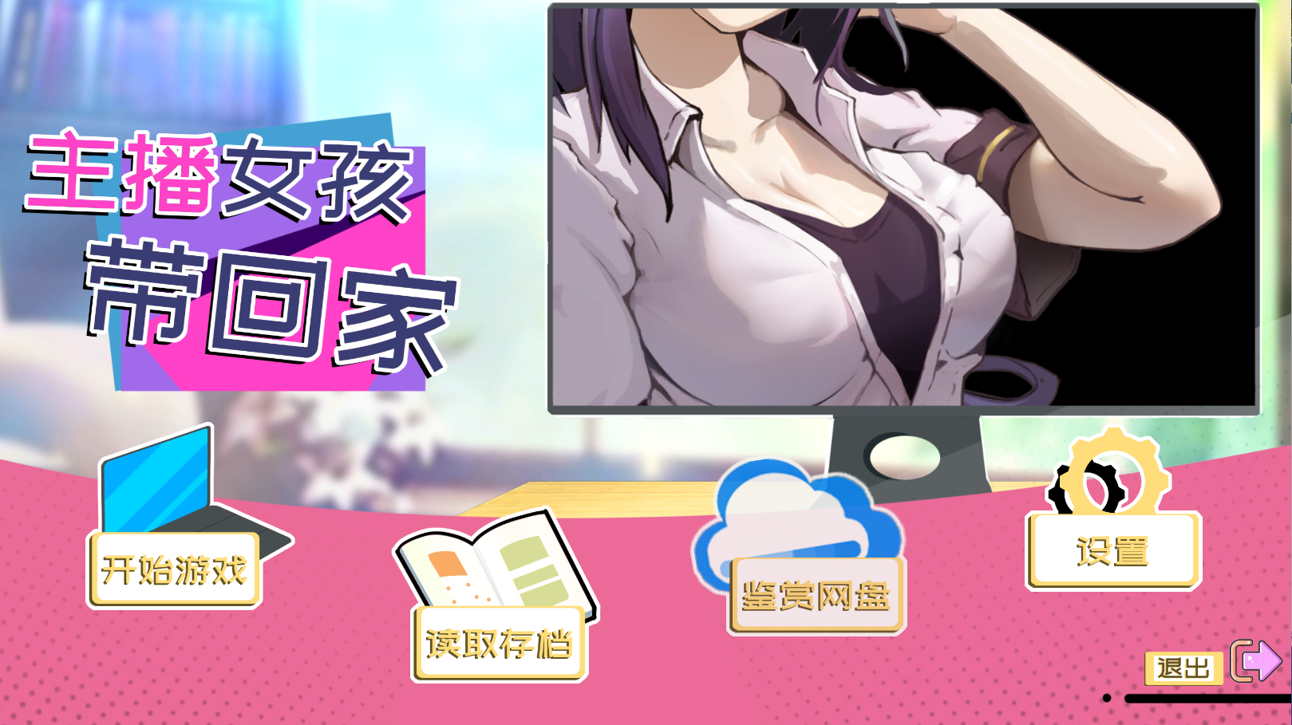
“主播女孩带回家”tutorials

Slide 2
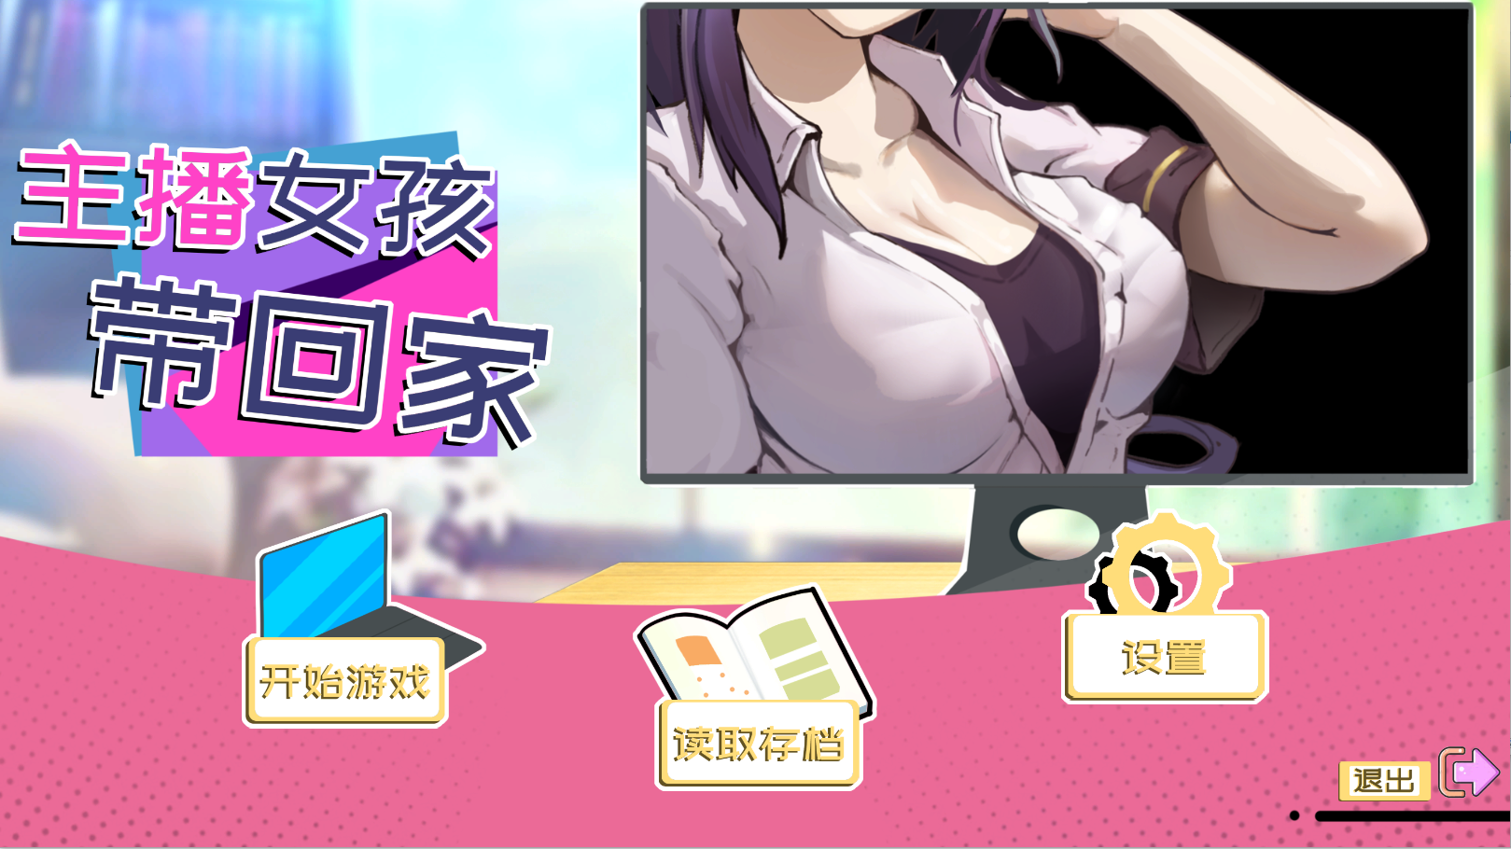
According to Steam's last feedback, 0：26 to 0：39 seconds of CG content comes from the tutorial and you need to create a new save to play.
When you finish the tutorial and play our full save, all adult content in our game is over, and that's all of our game
The new archive

Slide 3
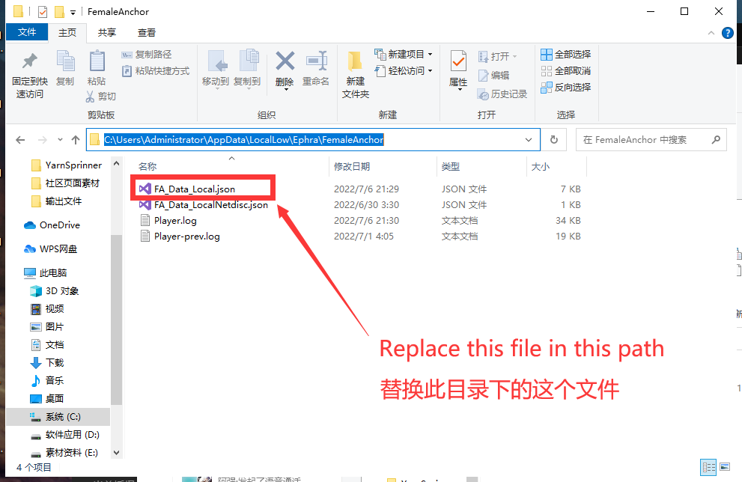
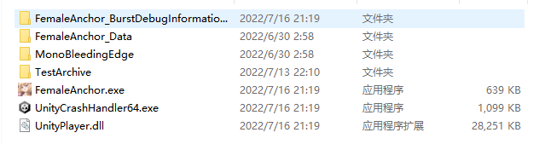
If you want to experience our adult content as soon as possible, please click on the TestArchive folder and replace the "FA_Data_Local.json" file with "C:\Users\Administrator\AppData\LocalLow\Ephra\FemaleAnchor"
After opening the game at this point, you can click the second button on the interface to read a full archive

Slide 4
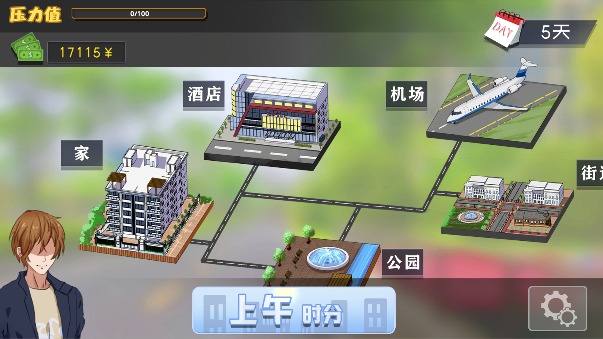
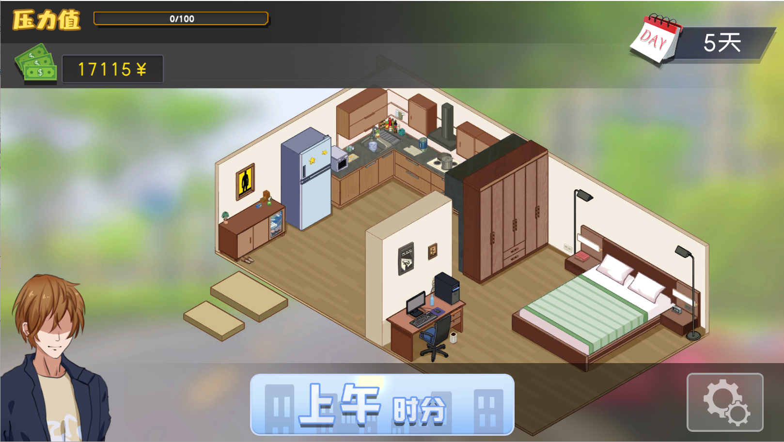
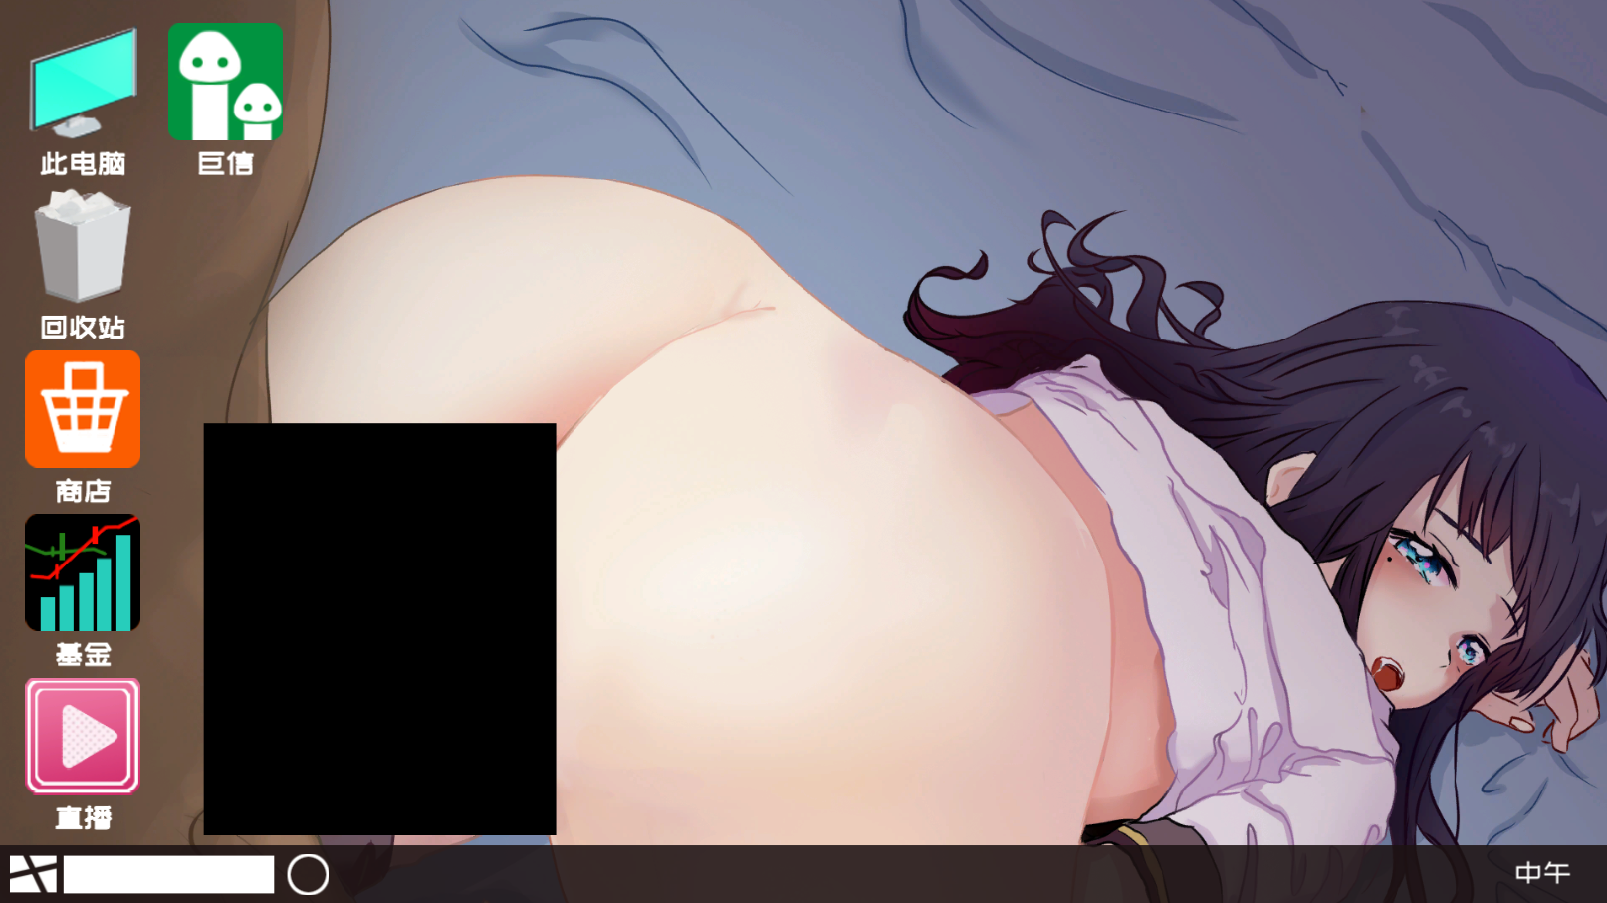
Please click the computer in the "Home(家)" scene to enter the computer desktop. There are applications such as "Store(商店)", "Juxin(巨信)" and "Live(直播)" on the computer desktop.
Out of the door
Juxin(巨信)
Store(商店)
Click "Live(直播)" to enter the live page, currently only one anchor is live

Slide 5
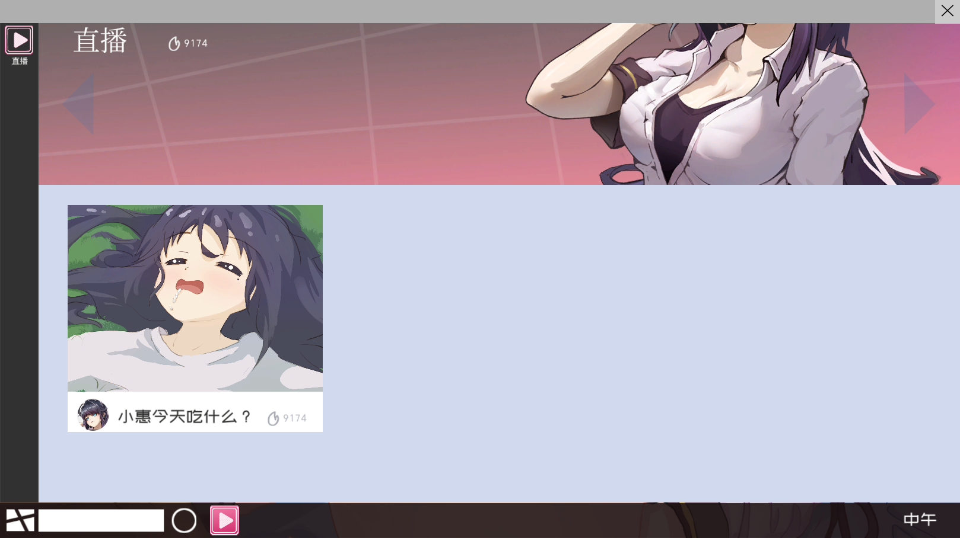
Click here

Slide 6
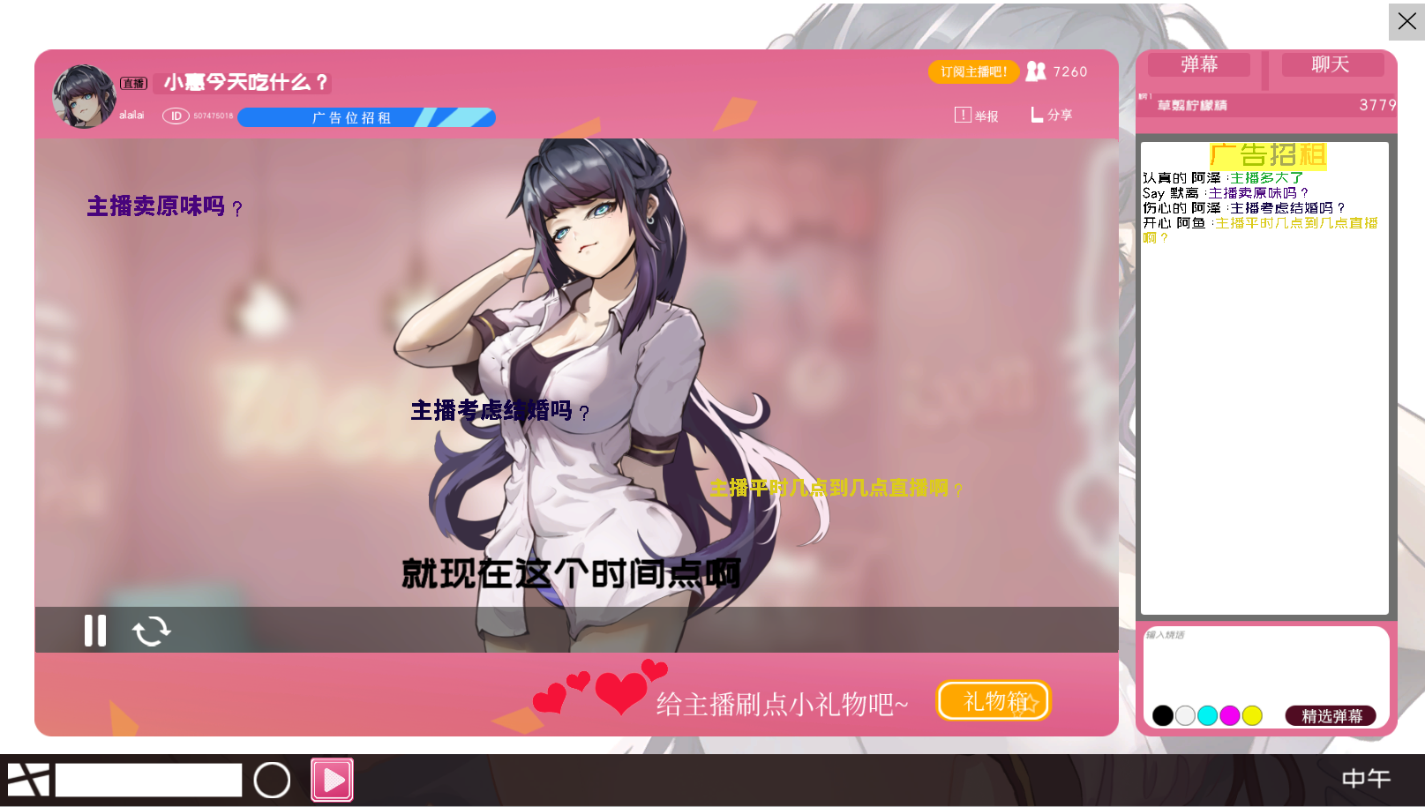
You can use the money provided by the archive to choose to give gifts to the streamer in the "gift box(礼物箱)". The "heart" on the left of the "gift box(礼物箱)" represents the current streamer's favorability to you
Every time a "heart" is lit, it means that you have completed a stage of favorability
At this point, you can click the "X" in the upper right corner to exit the live broadcast page and return to the "Desktop"
heart
gift box(礼物箱)

Slide 7
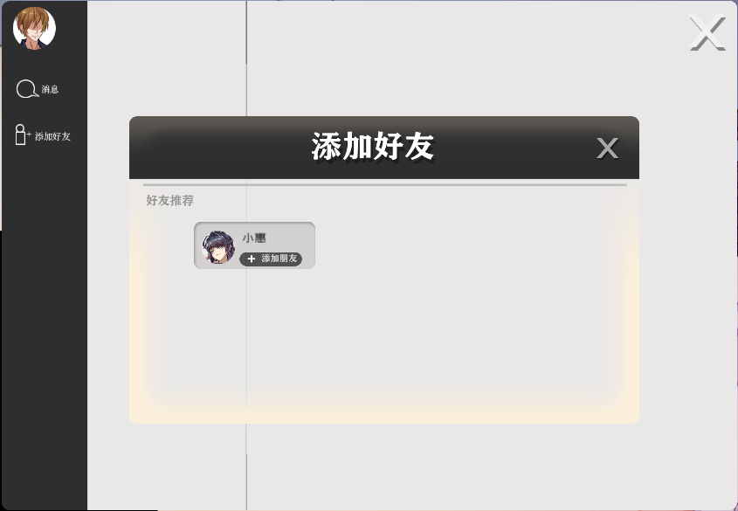
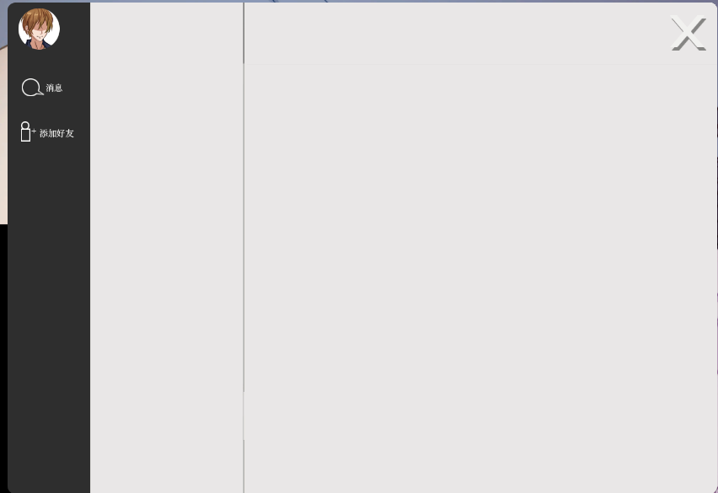
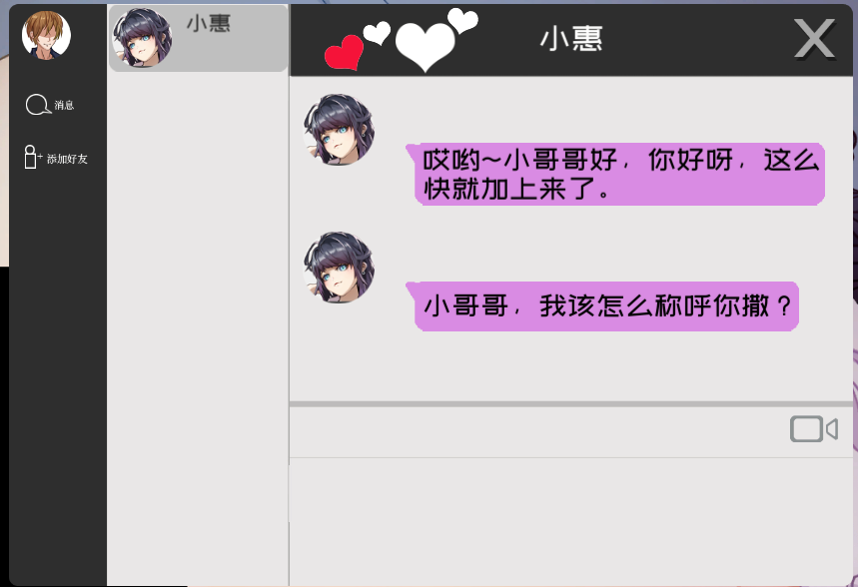
Click "Juxin(巨信)", select "Add Friend(添加好友)", you can see that the host has sent you a friend request, click "Add Friend(添加好友)" to successfully add the host as a friend
You can see the avatar of the anchor appear in your dialog box, click on the avatar of the anchor to enter the dialogue

Slide 8
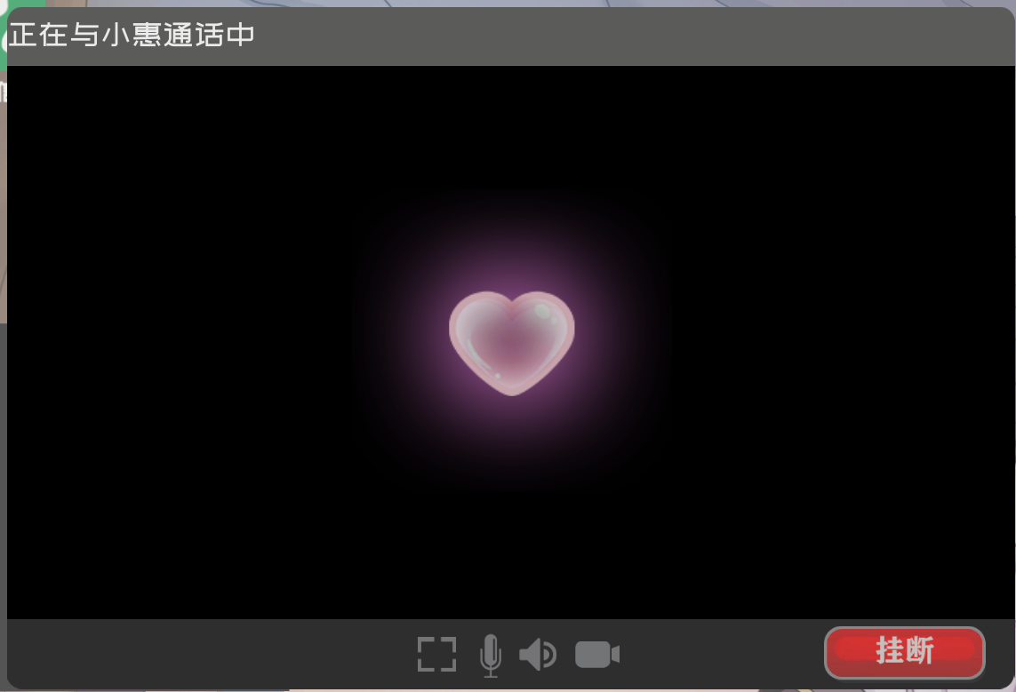
Every time you light up a heart, you have a chance to make a video call with the host
Click the "Camera" button in the dialog box to send a video call to the host
At this point, you're watching our adult content section.
"Camera" button

Slide 9
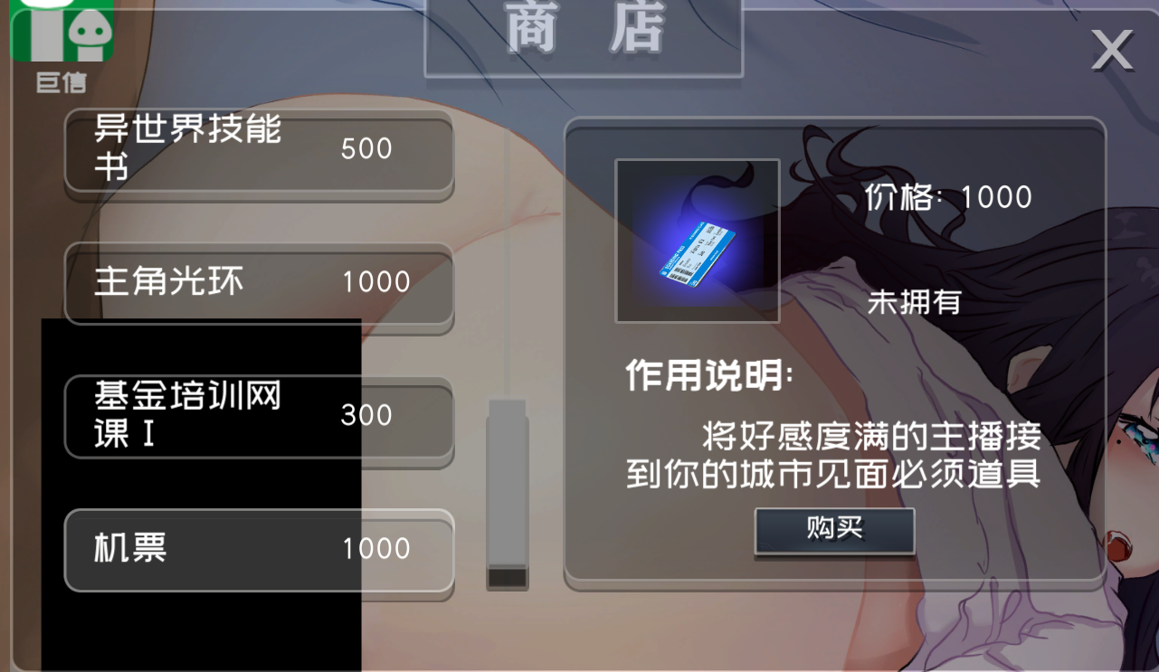
Store(商店)
When your friendship with the host reaches 4 "hearts", you can exit "Juxin(巨信)"
Click on the "Store(商店)" application on the desktop to enter the store page and buy air tickets
air tickets

Slide 10
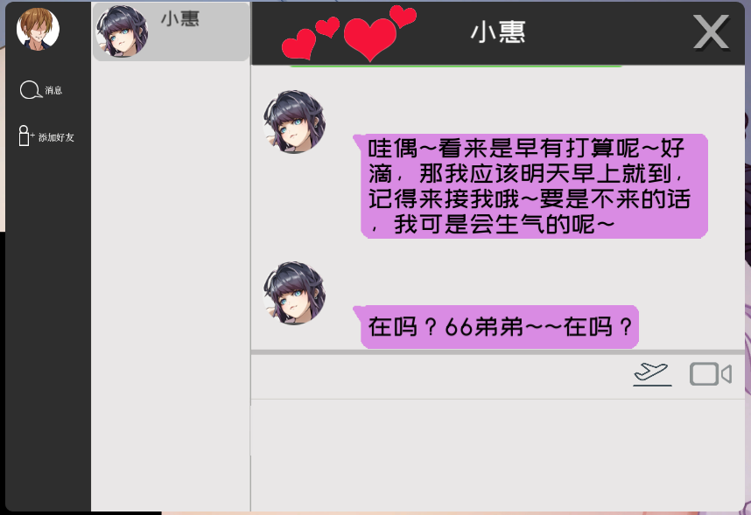
You just need to click the "Airplane(机场)" button in the conversation between "Juxin(巨信)" and the host, and the host will accept your invitation
However, it should be noted that you must go to the airport the next day
Click the white rectangle button in the computer taskbar to exit "Computer"
Note the number of days in the upper right corner
Click on the "Entrance" in the scene to come to the big map

Slide 11
Click "Bed" to quickly pass the current time period until the next day

Slide 12
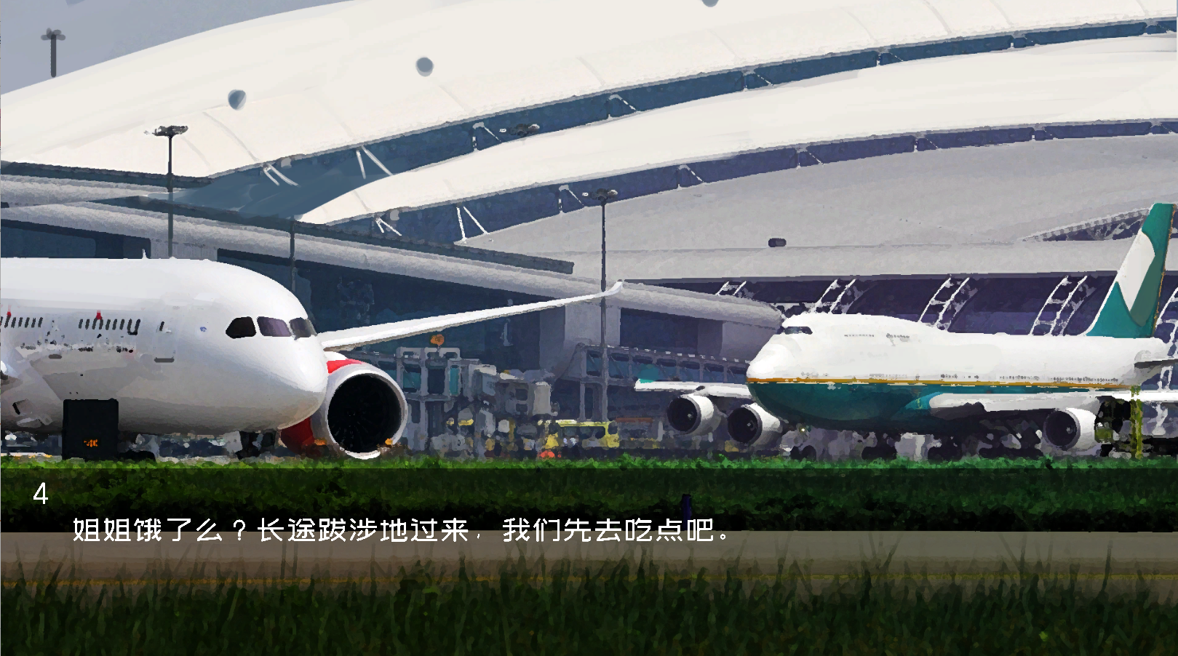
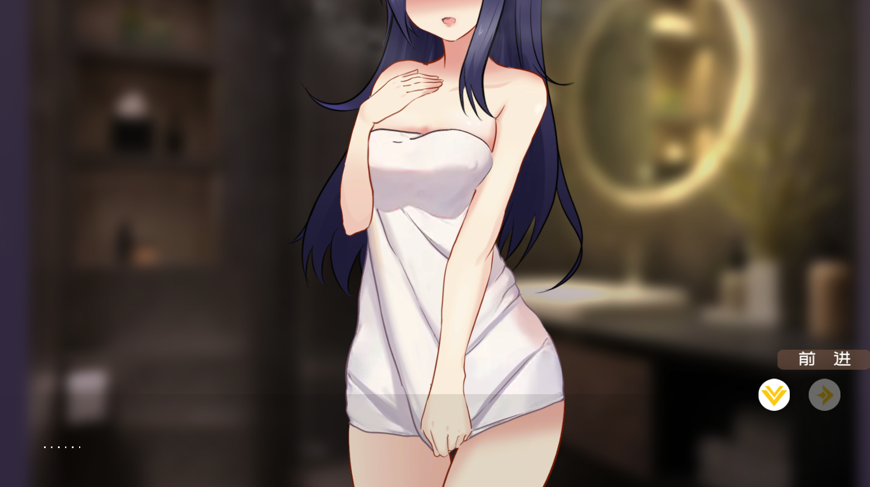
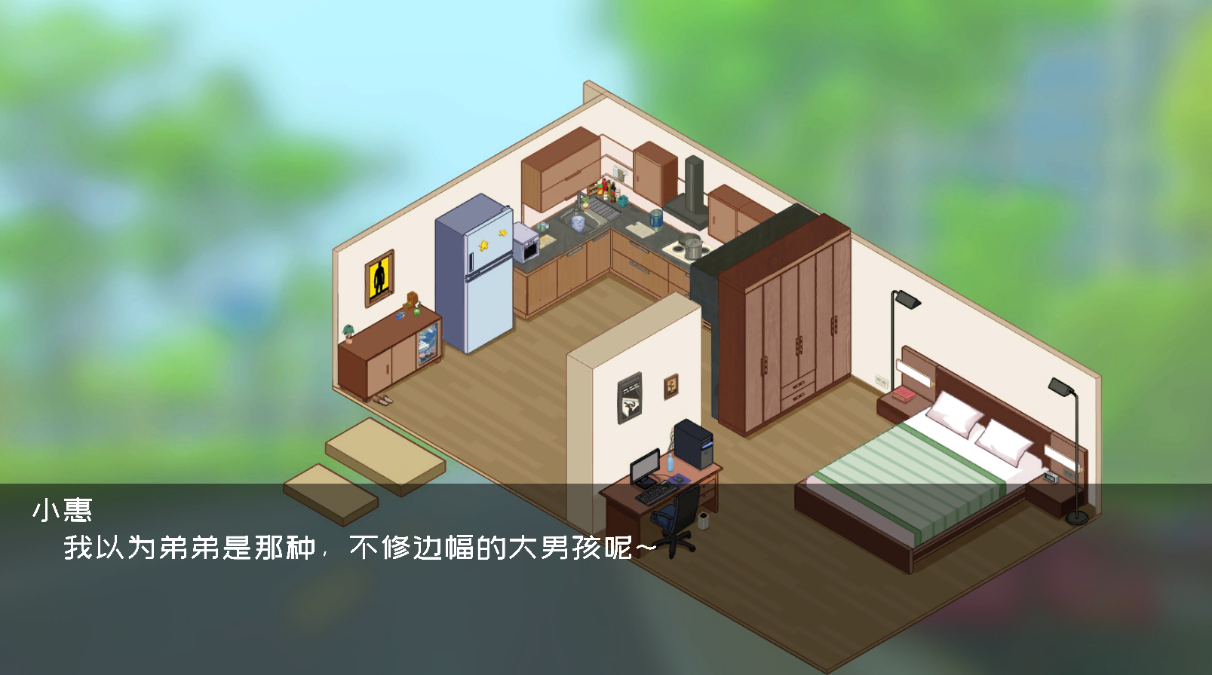
After clicking "airport" to complete the conversation, you can take the host home, and the process of the game ends.

